Slide 1
CS213 Recitation 7
Notes:
Hello, everyone. In today’s recitation, let’s go over some knowledge points about JavaFX UI control, Event Driven programming and JavaFX CSS

Slide 2
JavaFX UI Controls
Event Driven Programming
JavaFX CSS
Notes:
These are the contents we will cover today.

Slide 3
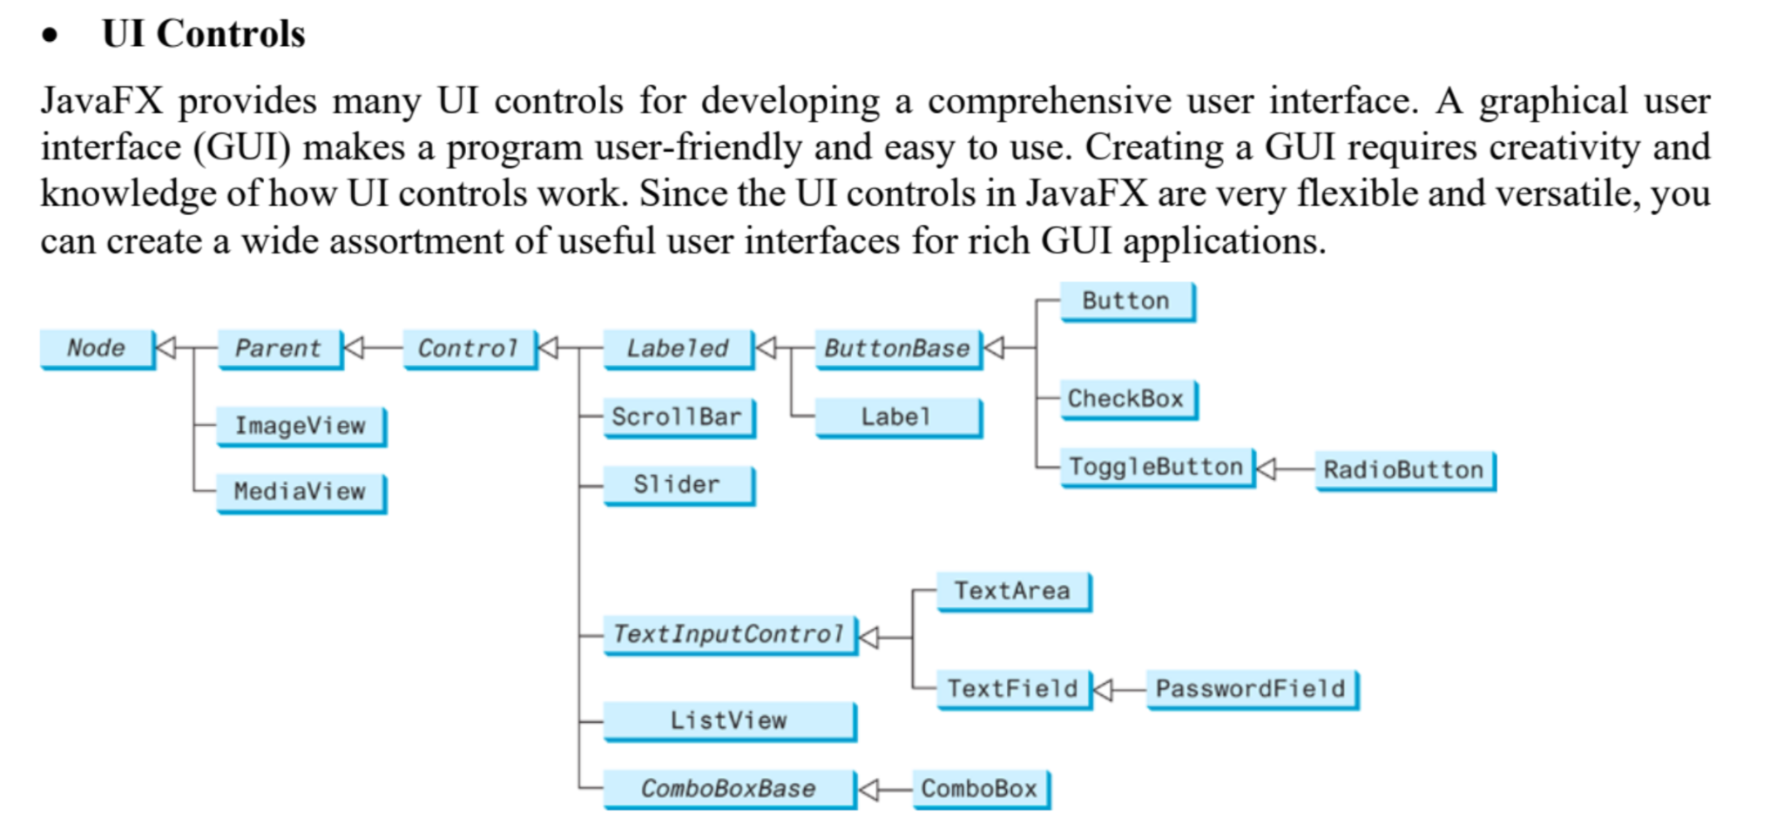
Notes:
(Read slides)
This is the class hierarchy of Java UI Control classes.

Slide 4
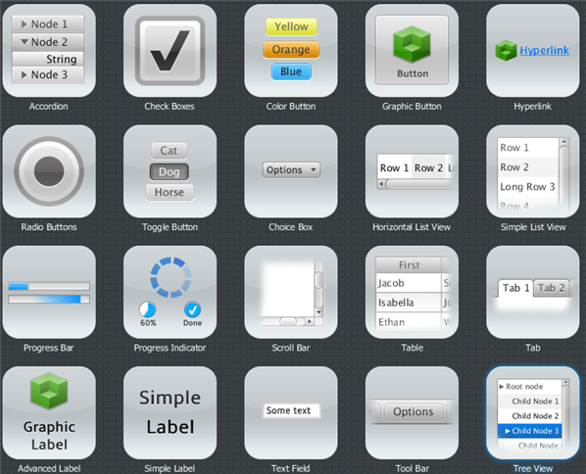
Notes:
This picture is an example of the UI controls JavaFX provide.

Slide 5
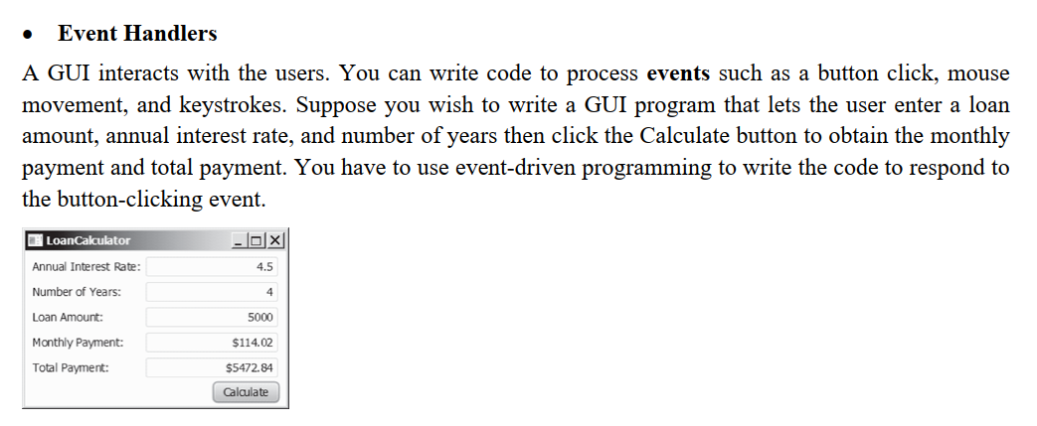
Notes:
(read slides)

Slide 6
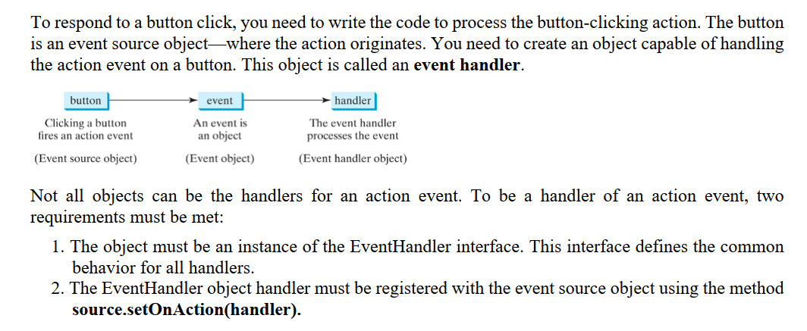
Notes:
(read slides)

Slide 7
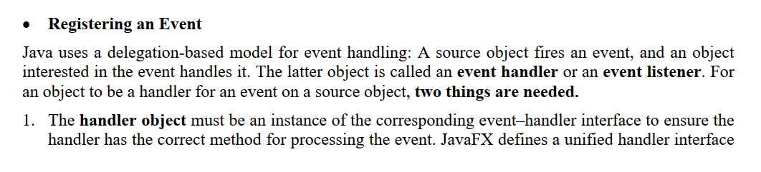
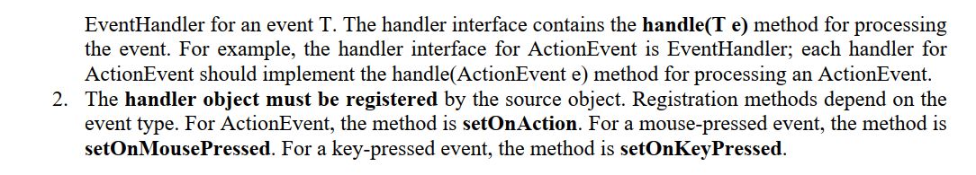

Slide 8
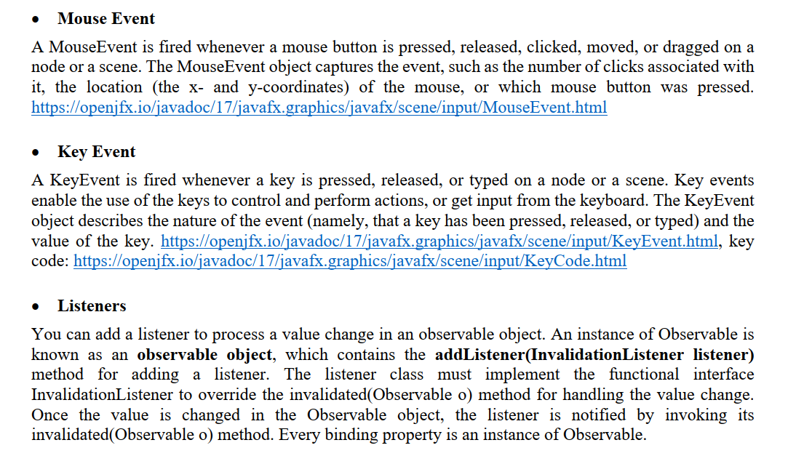

Slide 9
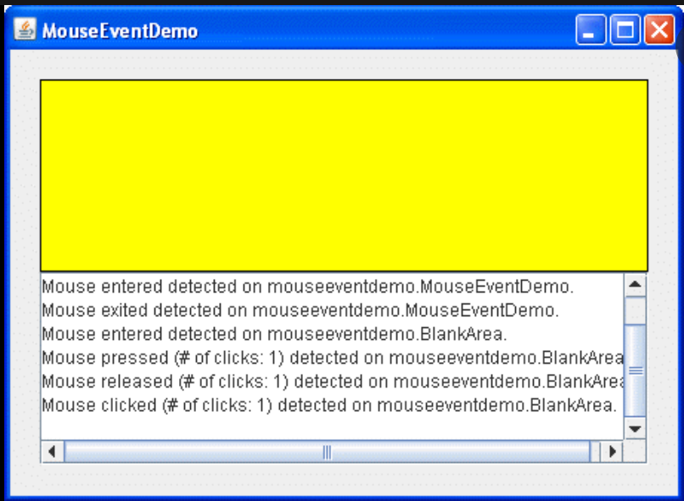
Notes:
This is a Demo for Mouse Event. It can detect mouse event such as Mouse enter, exist, press, release and click.

Slide 10
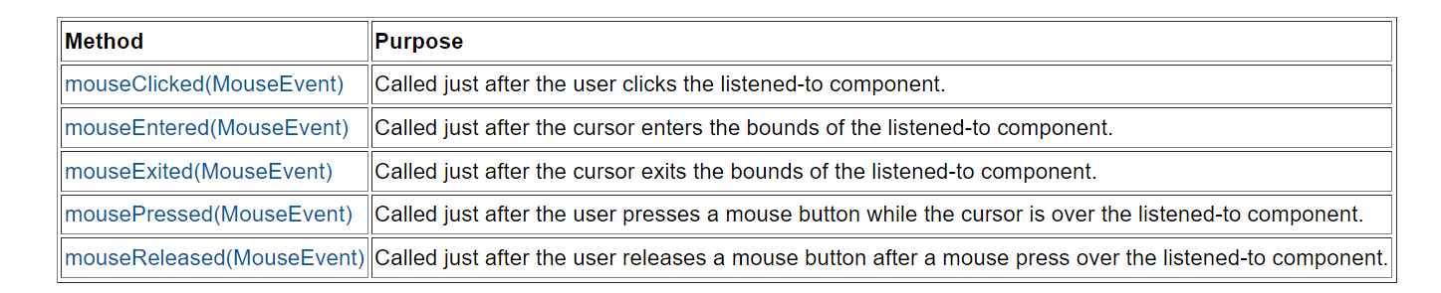
Notes:
These are the methods related to mouse events.

Slide 11
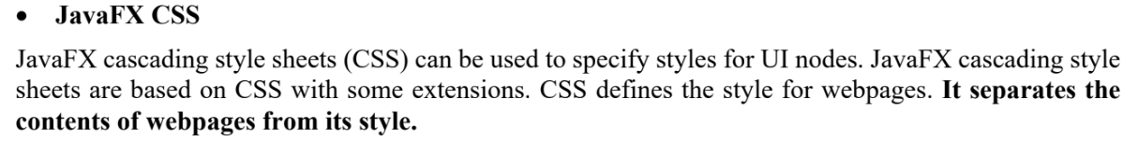
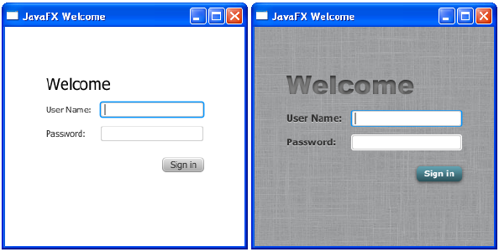
Notes:
This is a compare of using CSS and not using CSS.

Slide 12
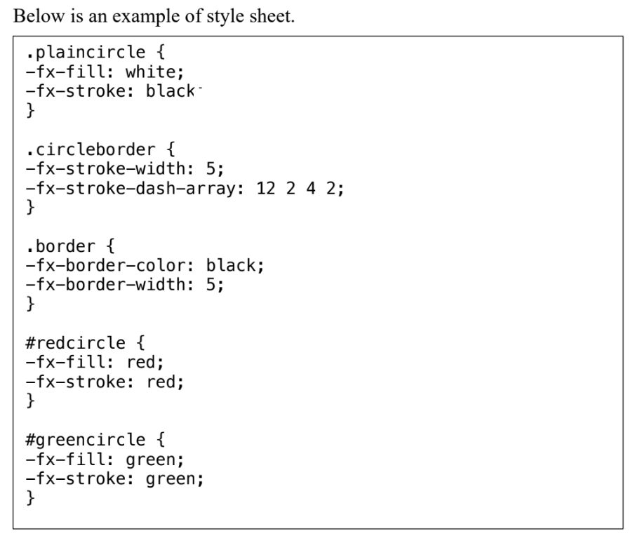
A JavaFX CSS file makes it easy to modify the style without modifying the Java source code. A JavaFX style property is defined with a prefix –fx- to distinguish it from a property in CSS.
Notes:
A style sheet uses the style class or style id to define styles. Multiple style classes can be applied to a
single node, and a style id to a unique node. The syntax .styleclass defines a style class. In the above
example, the style classes are named plaincircle, circleborder, and border. The syntax #styleid defines
a style id. Here, the style ids are named redcircle and greencircle. Each node in JavaFX has a styleClass
variable of the List type, which can be obtained from invoking getStyleClass(). You can add multiple
style classes to a node and only one id to a node. Each node in JavaFX has an id variable of the String
type, which can be set using the setID(String id) method. You can set only one id to a node.

Slide 13
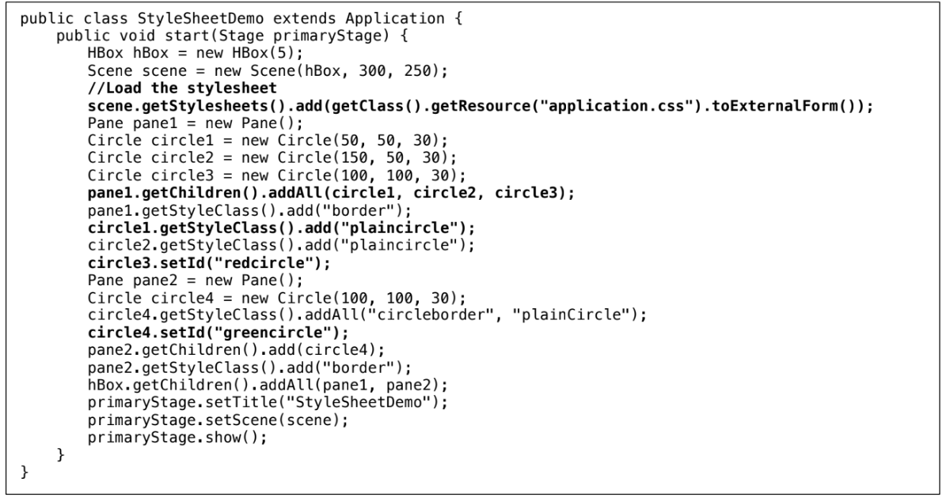
Notes:
The program loads the style sheet from the file application.css by adding it to the stylesheets property
of the Scene object. The file should be placed in the same directory with the source code for it to run
correctly. After the style sheet is loaded, the program sets the style class plaincircle for circle1 and
circle2 and sets the style id redcircle for circle3. The program sets style classes circleborder and
plaincircle and an id greencircle for circle4. The style class border is set for both pane1 and pane2. The
style sheet is set in the scene, thus, all the nodes inside the scene can use this style sheet. Note the style
class plaincircle and id greencircle both are applied to circle4. plaincircle sets fill to white and greencircle
sets fill to green. The property settings in id take precedence over the ones in classes. Thus, circle4
will be displayed in green in this program.

